Slide 1
W4111 – Introduction to Databases Section 002, Spring 2021
We will start in a couple of minutes
© Donald F. Ferguson, 2021

Slide 2

COMS W4111: Introduction to Databases, Section 002, Spring 2021
Lecture 1: Introduction, Course Overview, Foundational Concepts, Some Motivating Examples
Donald F. Ferguson (dff@cs.columbia.edu)
© Donald F. Ferguson, 2021

Slide 3

We will start in a couple of minutes
3 | COMS W4111_002_2021_1: Lecture 1: Introduction, Course Overview, Foundational Concepts © Donald F. Ferguson, 2021

Slide 4
Contents
4 | COMS W4111_002_2021_1: Lecture 1: Introduction, Course Overview, Foundational Concepts © Donald F. Ferguson, 2021

Slide 5
Contents
Introduction
Logistics, about your instructor, OHs, TAs.
Homework, exams.
Target application/solution/project.
Core concepts
Motivating examples (Gives you a feel for programming and non-programming projects).
Introductory concepts: data, databases, database management systems.
Application, application architectures, roles.
Database design, Entity-Relationship Model (Part 1)
Database design process.
ER-Model and diagrams.
The theory: The Relational Model (Part 1)
Relational model, schema, keys, schema diagrams.
Basics of relational algebra.
The realization: Structure Query Language (SQL) (Part 1)
Basics of Data Definition Language.
Basics of Data Manipulation Language (Query).
Homework 0 – Definition and discussion.
Read chapter 1 slides.
Will cover in recitation.
Note:
Make sure I do enough hands-on examples to support HW 1.
Will also cover in recitation and lecture 2.

Slide 6
Introduction
Logistics
Exams, Homework
Target Application Scenario
6 | COMS W4111_002_2021_1: Lecture 1: Introduction, Course Overview, Foundational Concepts © Donald F. Ferguson, 2021

Slide 7

Logistics
7 | COMS W4111_002_2021_1: Lecture 1: Introduction, Course Overview, Foundational Concepts © Donald F. Ferguson, 2021

Slide 8
Waitlist
The administrative staff of the Dept. of Computer Science directly manages enrollment in the W4111 sections and the wait lists. This is true of several courses.
COMS W4111 is ALWAYS oversubscribed and has huge wait lists.
The course is a requirement for several majors and tracks.
There are complex rules about prioritizing students for course enrollment, and also which students can take the hybrid section.
Section 002, Spring 2021 is like all sections of W4111, but has some special emphasis on supporting (MS) students in Data Science Institute.
In place of required COMS 4121, which is not taught this year.
DSI students have first enrollment priority, followed by CS Dept. prioritization for enrollment.
Faculty follow department policies and do not manage waitlists, despite the list that identifies the waitlist as “Instructor Managed.”
Contacts: You must work with administrative leaders on enrollment:
Computer Science: Cynthia Meekins, cynthia@cs.columbia.edu)
Data Science Institute: Brianne Cortese (bc2640@columbia.edu)

Slide 9
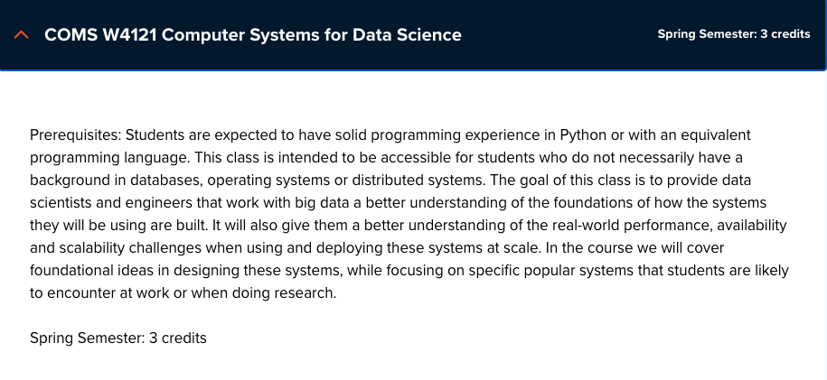
A Comment about this Section
The department has trouble offering W4121
W4121 is a requirement for M.S. in Data Science.
The DSI and CS Dept. have been substituting
W4111 for
W4121
The CS Dept. asked me to prioritize my section for M.S. in Data Science students.
I will try to adapt the syllabus to support:
CS students.
Non-CS students.
DSI students.
If you are a DSI student, there will be content that I tailor to have W4111 better meet your needs.
If you are not a DSI student, you will get the same benefits from this section as previous versions of W4111 that I taught.

Slide 10
Lecture Format, Recitation, Office Hours
Lecture: Friday, 10:10 to 12:40 – This is a hybrid section, like many classes this fall.
The in-person lectures are optional. I encourage you to attend in-person if you are on campus.
I will hold as many lectures in-person as possible but may hold some lectures online only.
I will announce in advance if I plan to hold a lecture online only.
Lectures are streamed and recorded.
Students can attend in-person, watch the stream or watch the recording. These options are available to all students.
There are limitations on how many students can attend in person due to social distancing. I will provide a sign-up method to reserve seats if necessary.
Recitation: Optional recitation on Saturday, 10:00 to 11:30.
Either in-person/online or just online. Will announce in advance.
Will hold when there is student interest, homework due, exams, etc.
Office hours: (Friday: 0830 to 1000, 1300-1400; and by-request as needed)
I will hold on-campus and online offices hours. There will be online office hours that accommodate all time zones.
I will be on campus when possible for students that want to speak with me or need more focused help.
I will publish in-person OH when I plan them.
I will provide a sign-up mechanism for in person office hours if necessary.
Note: Your health, safety and well-being are ALWAYS my primary concern. These are bizarre, stressful times. Speak to me if you need special considerations and I will do the best that I can.

Slide 11
Additional Basic Course Logistics
Lecture: Friday, 10:10 AM-12:40 PM, Room TBD
Instructor: Donald F. Ferguson (dff@cs.columbia.edu)
Office Hours:
Fridays: 8:30 AM - 10:00 PM, 1:00 - 2:00 PM (Location TBD; in-person and online)
By appointment, as needed, as available.
I hold a lot of extra office hours, usually on weekends.
I typically post on Piazza when I will have extra availability.
The extra OHs may be "recitations," in which I go over exam questions, homework, etc.
Extra OH and recitations are often on the weekend or in the evening.
I will be flexible about time zones for extra office hours to accommodate students.
Recitation Section R02: This is an optional recitation/office hours. It will be in person (when possible) and on-line. You do not need to register for it.
Collaboration/Contact/Content:
The class is on Piazza for general questions, feedback, exam/homework clarification, ... ...
The course lectures, sample code, etc. will be on GitHub.
GitHub home page
Repository – contains lectures, examples, etc.
There is a Slack Team/Group for my courses. Please join the channel w4111-f2w.

Slide 12
Observations from Last Semester
Student evaluation:
I pay a lot of attention to students’ evaluations and comments.
Fall 2020 evaluations:
Course overall quality was 3.49 (out of 5). My past average has consistently been over 4.1.
Instructor overall quality was 3.66. My past average has consistently been over 4.1.
Some recurring (negative) themes:
“This is the most disorganized course I've taken.”
HW assignments are vague and unclear.
Too much work.
We will try to make improvements this semester.
Much, much better adherence to a HW and exam cadence/schedule.
We will make the HW assignments definitions clearer, but not as clear as you want.
Relying very heavily on the head TAs for homework/exam definition, explanation, ... ...
Will have periodic checkpoint polls to get feedback and change suggestions.

Slide 13
About Your Instructor
13 | COMS W4111_002_2021_1: Lecture 1: Introduction, Course Overview, Foundational Concepts © Donald F. Ferguson, 2021

Slide 14

About your Instructor
35 years in computer science industry:
IBM Fellow
Microsoft Technical Fellow.
Chief Technology Officer, CA technologies.
Dell Senior Technical Fellow.
CTO, Co-Founder, Seeka.tv.
Ansys Fellow
Academic experience:
BA, MS, Ph.D., Computer Science, Columbia University.
Approx. 15 semesters as an Adjunct Professor.
Professor of Professional Practice in CS (2018)
Courses:
E1006: Intro. to Computing
W4111: Intro. to Databases
E6998, E6156: Advanced Topics in SW Engineering (Cloud Computing)
Approx. 65 technical publications; Approx. 12 patents.
Personal:
Two children:
College freshman (Ithaca College).
2019 Barnard Graduate.
Hobbies:
Krav Maga, Black Belt in Kenpo Karate.
1LT, New York Guard.
Bicycling.
Astronomy.
Languages:
Proficient in Spanish.
Learning Arabic.

Slide 15
About the Course
15 | COMS W4111_002_2021_1: Lecture 1: Introduction, Course Overview, Foundational Concepts © Donald F. Ferguson, 2021

Slide 16
The Course
From the new/pending Columbia University Bulletin "Prerequisites: COMS W3134, COMS W3136, or COMS W3137; or the instructor's permission. The course covers what a database system is, how to design databases effectively and in a principled manner, how to query databases, and how to develop applications using databases: entity-relationship modeling, logical design of relational databases, relational algebra, SQL, database application development, database security, and an overview of query optimization and transaction processing. Additional topics generally include NoSQL, graph, object-relational, and cloud databases, as well as data preparation and cleaning of real-world data. The course offers both programming and non-programming paths for homework and projects, to accommodate students with different programming skills and backgrounds."
Prerequisites:
COMS W3134, COMS W3136, or COMS W3137 are data structures classes. All of these courses require extensive programming, in Java.
A course in data structures is helpful for this section of W4111 but not essential. I waive the requirement.
We will help you with any data structures knowledge you lack.
Programming in/for this class:
There will be a "non-programming" option, which we will discuss below.
For students who want to take the programming track, we will use Python. I will provide motivation for choosing Python below.

Slide 17
Course Objectives
Have fun, learn a lot and come to appreciate and enjoy some amazing technology. Data and databases have and will change the world.
Provide a foundation that allows you to succeed in future courses. This is an introduction to databases. The technology is crucial for future courses
Big data, data analysis, data science
Advanced database classes
Machine learning
Numerical and data analytics in operations research, engineering, economics, finance, life sciences, financial engineering, medicine, etc.
Enable you to successfully apply the technology in your work and profession.
Have cool stuff to talk about on interviews and in your resumes.

Slide 18
The Course – Value and my Perspective
This course is foundational, and will teach you the core concepts in
Data modeling
Data model implementation; Data manipulation.
Different database models and database management systems.
Implementation and architecture of data centric applications and database management systems.
ANY non-trivial application
Requires a well-designed data model.
Implements a data model and manipulates data.
Uses a database management system.
Understanding databases and database management is core to the “hottest fields” in computer science, e.g.
Data science
Machine learning
Intelligent (Autonomous) systems
Internet-of-Things
Cybersecurity
Cloud Computing
Database, database application, etc. skills are increasingly central to many disciplines, including:
Economics.
IEOR, financial engineering.
Mechanical and electrical engineering.
Medicine, pharmaceuticals
...
University courses on databases sometimes focus on theory and abstract concepts. This course will cover theory, but there will be an increased emphasis on:
Practical, hands-on applications of databases.
Patterns and best practices.
Developing and understanding database centric applications.
Using databases and various tools for data analysis, visualization and insight.
Personal perspective
A large percent of my career has been spent figuring out or leading teams that figured out how to model, implement and manipulate data.
I have used the information in this class more than anything else I have learned.
This will likely be true for you.

Slide 19
Surprising Example
Example: This is a photo of mean using a database during COVID-19 mobilization.
Match service members
To JTF-HQ requests for personnel
Based on assignment needs
And service member
Skills
Availability
Tracked in a DBMS.
The hardhat is because DB usage can be very dangerous 😱.
No joking: I had to build an application that used:
Relational DBMS.
Python, Jupyter Notebook.
Google Sheets with Apps Script.
Google Forms.
This technology and these skills are surprisingly applicable.

Slide 20
Environment
20 | COMS W4111_002_2021_1: Lecture 1: Introduction, Course Overview, Foundational Concepts © Donald F. Ferguson, 2021

Slide 21
Course Resources and Development Environment
Recommended textbook:
Database System Concepts. Seventh Edition. (ISBN 9780078022159)
There is a website associated with the textbook: https://www.db-book.com/db7/
Textbooks are expensive. You can easily get through the course using website, lecture material, ... ...
Signup for an AWS Account. We will start with creating an instance of Relational Data Service.
There are instructions on the course website. (Under HW0)
Using cloud systems reduces complex SW setup on your personal machines. Having used cloud systems is a useful skill and looks good on resumes
Install a new, most recent, isolated/single user instance of Anaconda environment.
You must install the most recent version for Python 3.
You can isolate the new instance from other instances to avoid conflicts, or set up custom environments.
Development environments: Students. Are entitled to a free, annual JetBrains professional license.
Students have had problems with MySQL Workbench. We will try DataGrip. Please install.
Installing PyCharm is recommended for all and required for the programming track.
See HW 0 for environment.
See website for additional information on environment, resources, etc. (https://donald-f-ferguson.github.io/W4111S21/reference-material.html)

Slide 22
Course Resources and Development Environment
Recommended textbook:
Database System Concepts. Seventh Edition. (ISBN 9780078022159)
There is a website associated with the textbook: https://www.db-book.com/db7/
Textbooks are expensive. You can easily get through the course using website, lecture material, ... ...
Signup for an AWS Account. We will start with creating an instance of Relational Data Service.
There are instructions on the course website. (Under HW0)
Using cloud systems reduces complex SW setup on your personal machines. Having used cloud systems is a useful skill and looks good on resumes
Install a new, most recent, isolated/single user instance of Anaconda environment.
You must install the most recent version for Python 3.
You can isolate the new instance from other instances to avoid conflicts, or set up custom environments.
Development environments: Students. Are entitled to a free, annual JetBrains professional license.
Students have had problems with MySQL Workbench. We will try DataGrip. Please install.
Installing PyCharm is recommended for all and required for the programming track.

Slide 23
Homework Exams
Grading
23 | COMS W4111_002_2021_1: Lecture 1: Introduction, Course Overview, Foundational Concepts © Donald F. Ferguson, 2021

Slide 24
Assignments, Exams, Grading
Point value of assignments and exams
50%: Homework assignments:
4 HWs, approximately one HW every two-three weeks.
Each is worth either 10 or 15 points based on difficulty.
Homework format:
Common to all tracks:
Questions requiring written answers and diagrams.
Implement/execute/test of various database operations required to solve a use case/question.
Format will be an iPython/Jupyter Notebook.
Track specific: Incremental development of a project:
Programming track – web application.
Non-programming track – data analysis/visualization.
Exams: Take home, the same for all tracks.
20% of grade is midterm exam score.
30% is final exam score.
97-100 points is an A. There are opportunities to get extra-credit.
All tracks will learn core concepts and get experience with other tracks’ focus topics.

Slide 25
To Program or Not To Program, ...
From the department's new guidance for the course:
"To accommodate the diverse backgrounds of the students who take this class, all sections of the class should include a non-programming option for projects and assignments. We (NOTE: Does not include me) have successfully offered such an option in some sections of the class for many years: students can either program a web application to interface with a DB of their own design, or alternatively follow the non-programming option and come up with a quantifiably more detailed DB design/data.
What does not constitute programming?
Writing queries for a relational, graph, document, or other data management system does not constitute programming and can be expected of all students.
What constitutes programming?
Reading more than a handful (1-5) lines of code, Writing Python code that is not directly required to write a query."
Why I previous only did a programming track:
Any non-trivial use of data and databases in any field requires programming. This is not Star Trek. You cannot shout, "Computer! Analyze ..."
You might think, "But, I do not want to program. I want to go into financial services, private equity, medicine, ... I can just use tools like Pandas or Tableau. You will do some programming for complex scenarios. Get over it.
Tracks: Programming and non-programming.
There is a common core that involves understanding concepts, modeling data, using databases, etc.
Exams are the same for both tracks. Mix of written questions and practical exercises. Completely take home with several days to complete.
Homework assignments: There is a common core on all assignments for both tracks. Additionally,
Programming track will incrementally build a database centric, cloud-based web application.
Non-programming track will do a more complex, database centric project.

Slide 26
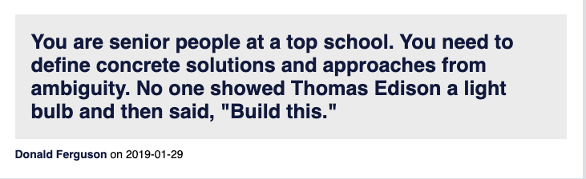
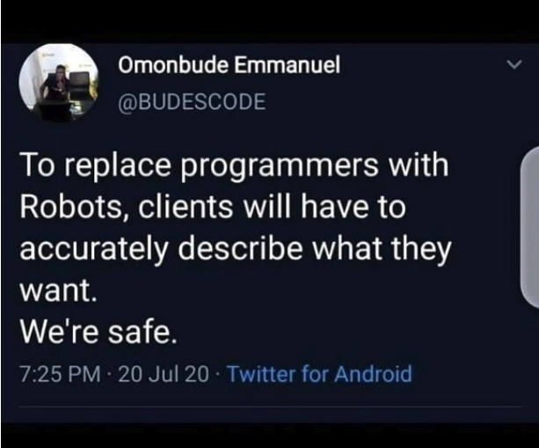
Homework Assignments
My homework assignments are:
Open ended.
Vaguely specified.
You will complain. I will listen sympathetically.
You will savage me on the instructor reviews and CULPA.
My professional colleagues and I will laugh at you behind your back.
Management, clients, partners, etc.
Do not understand technology as well as we do.
You will get requirements like, “I want it colored mauve because that has more RAM.”
Converting vague requests into a useful, meaningful project that we can implement is what we do. Get over it.
BUT, I WILL SIGNIFICANTLY IMPROVE CLARITY AND DETAILS.

Slide 27
Homework and Projects
27 | COMS W4111_002_2021_1: Lecture 1: Introduction, Course Overview, Foundational Concepts © Donald F. Ferguson, 2021

Slide 28

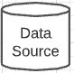
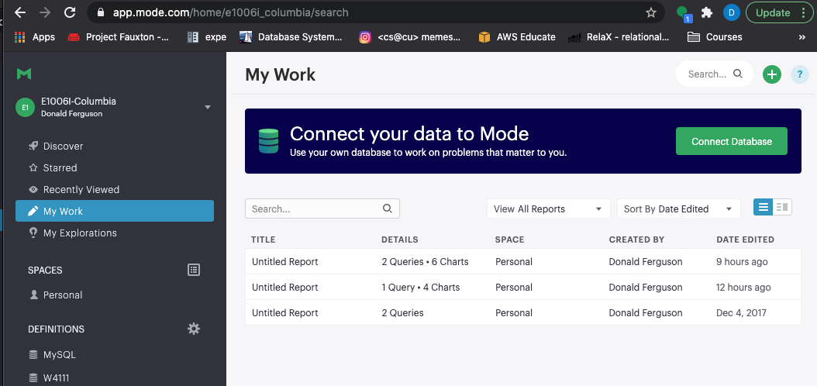

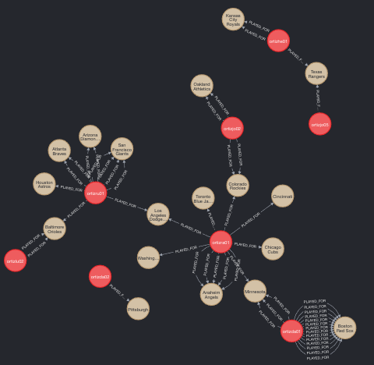
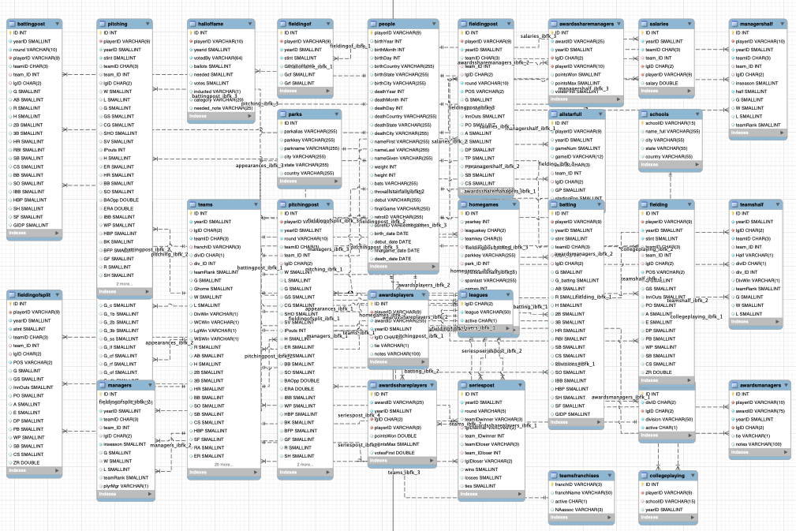
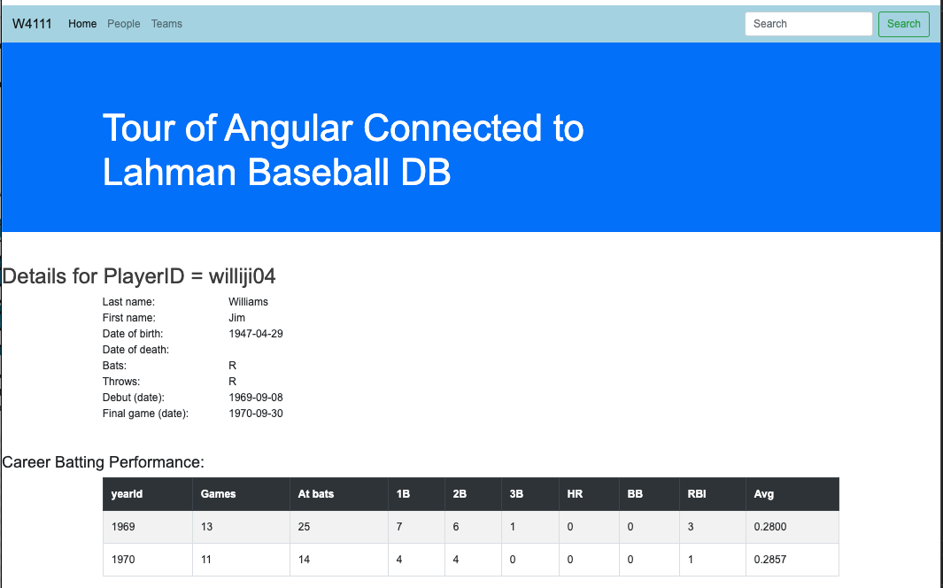
Target Application/Project(s)
Data Insight Service
Data Lake
Web Application
Social Network Service
DB Access Service
Core Data Service
Comment Discussion Service

Slide 29
Target Application/Project
That diagram was pretty confusing.
Basically, what it comes down to is that there will be major subsystems:
Interactive web application for viewing, navigating and updating data. The updates have to preserve semantic constraints and correctness.
A decision support warehouse/lake that allows us to explore data and get insights.
Programming and non-programming tracks will get experience with both, but
Non-programming track focuses on data engineering needed to produce (2).
Programming track will focus on (1).
The example that I will use is fantasy baseball because it covers both aspects, and there is a lot of interesting data available.
You will have some freedom on the data models and scenarios you choose.

Slide 30
Core Concepts
30 | COMS W4111_002_2021_1: Lecture 1: Introduction, Course Overview, Foundational Concepts © Donald F. Ferguson, 2021

Slide 31
COVID-19 and Population Data
31 | COMS W4111_002_2021_1: Lecture 1: Introduction, Course Overview, Foundational Concepts © Donald F. Ferguson, 2021

Slide 32
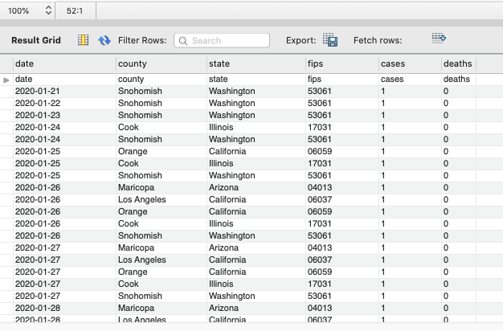
First Source of Information – NY Times
NY Times Dataset (https://github.com/nytimes/covid-19-data)
Date
County
State
FIPS
Cases (to date)
Deaths (to date)
I did not pick this data for any reason other than it is simple for a demo.

Slide 33
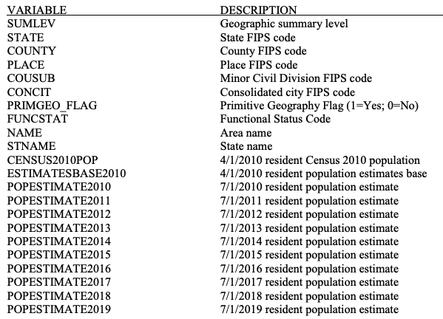
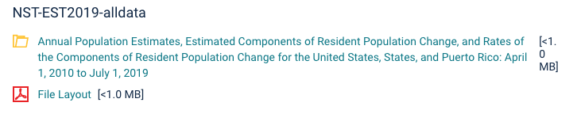
Second Source of Information
United States Census Bureau – City and Town Population Totals: 2010-2019 (https://www.census.gov/newsroom/press-kits/2019/national-state-estimates.html)
A subset of the fields.
A lot of online data comes with a PDF or txt explaining the fields, values, sources, etc.

Slide 34
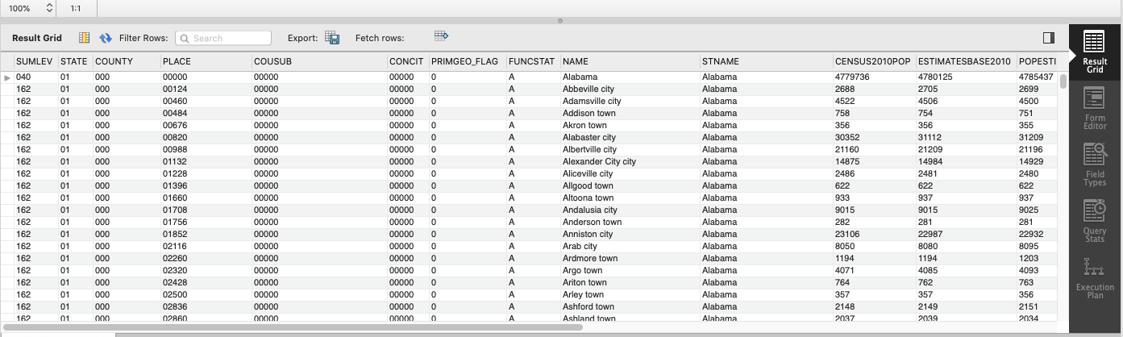
Second Source of Information (Sample)
Why do I need a census data?
Total death/sickness numbers are meaningless without considering population.

Slide 35
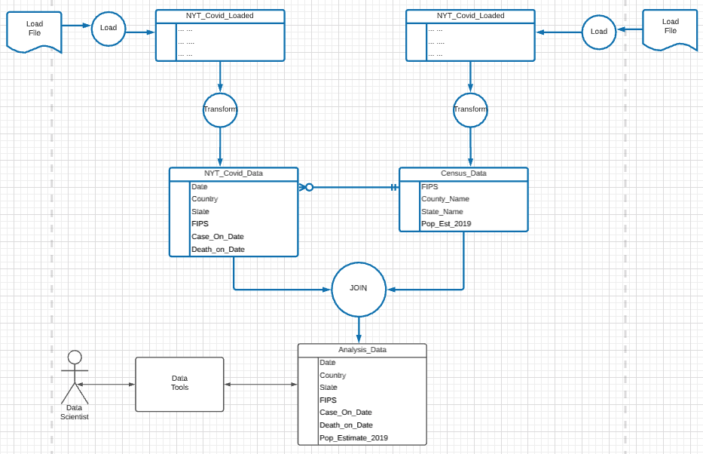
Preparing the Data for Data Science
Database and Software Engineering (This course)
Data Science

Slide 36
Problem 1 – Join on FIPS Codes
There are two sets of data linked by values in columns:
NY Times data FIPS column.
Census Data Place concatenation of state and county codes.
No. of rows: NY Times Data – 870K, Census Data: 81K
Producing a new “table” that contains matching rows can be tricky.
I could write a program, or
There is a complicated set of instructions I can follow to accomplish in Excel.
Even if I could figure it out, it would execute slowly. There are a lot of possible matches.
It would seem that solving this problem of efficiently “joining” rows from multiple, large tables based on column values is a common problem.
It would be nice if there were something that could implement the operation in a general way for arbitrary tables.
Oh. And the Census data is by town, and I need to roll up by county. This just got harder.

Slide 37
Data Engineering Problems
Problems:
Basic problems
Get and load the data in some form that I can handle.
Perform two transforms:
NYT Data: Convert the cumulative cases and deaths to daily cases and deaths.
US Census Data:
Drop columns for population estimates except for 2019.
Merge some columns to produce a FIPS.
Aggregate/Sum individual town/place values to produce county values.
Moderately complex problem: Join the data to correlate population data and deaths/cases.
Complex problem: Resolve inconsistencies and mismatches.
There are several ways to solve these problems.
Write programs, but they would be specific to this problem.
Do a lot of editing in spreadsheets, but this can be tricky and will not work for enormous datasets.
These operations seem like operations that are common to many scenarios. If we had a thing that solved the problems in a general way, it would be awesome.

Slide 38
Go to Notebook

Slide 39
Data Engineering Problems
Problems:
Basic problems
Get and load the data in some form that I can handle.
Perform two transforms:
NYT Data: Convert the cumulative cases and deaths to daily cases and deaths.
US Census Data:
Drop columns for population estimates except for 2019.
Merge some columns to produce a FIPS.
Aggregate/Sum individual town/place values to produce county values.
Moderately complex problem: Join the data to correlate population data and deaths/cases.
Complex problem: Resolve inconsistencies and mismatches.
There are several ways to solve these problems.
Write programs, but they would be specific to this problem.
Do a lot of editing in spreadsheets, but this can be tricky and will not work for enormous datasets.
These operations seem like operations that are common to many scenarios. It would be awesome if we had a thing that solved the problems in a general way.
Remember this aspiration/question?

Slide 40
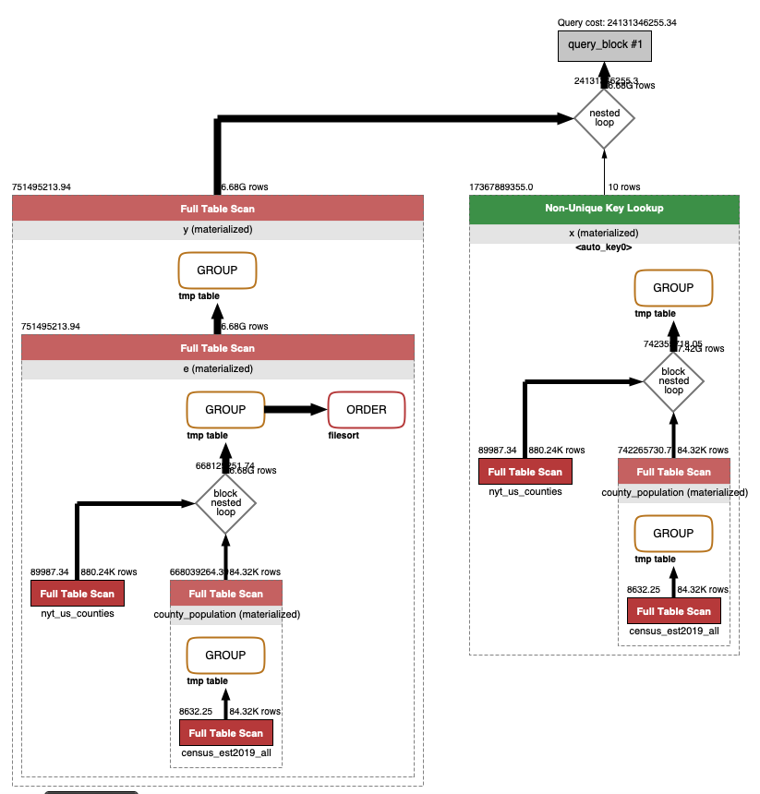
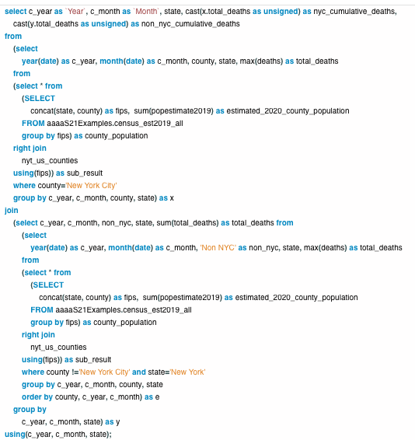
Query Engines
Database Engine
SQL seems complex. Once you learn SQL, it is more productive than hand writing code.
We will also see that the engine performs sophisticated performance optimizations.

Slide 41

Hmm. That was some dark magic, but ... ...
That was some dark magic, but what about population?
I started this example with the complexity of “JOINing” data from two tables.
COVID data.
Census population data.
I observed that I could not due the final step because ..., it turns out the data is incomplete.
NYT COVID data has one number for NYC.
But, ... NYC is five counties.
I could not do the JOIN.
This requires me to perform Data Cleansing.

Slide 42
Data Cleansing
https://blog.amplitude.com/big-data-cleanup
Database and data science classes love to teach the fun stuff queries, data modeling, machine learning, spooky math, algorithms, ... ...

Slide 43
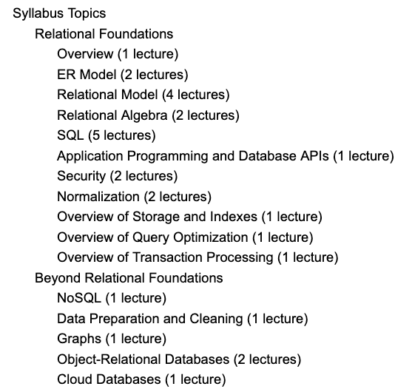
Data Cleansing
Recommended Syllabus
I place more emphasis on data cleansing and refactoring than other sections of W4111.

Slide 44

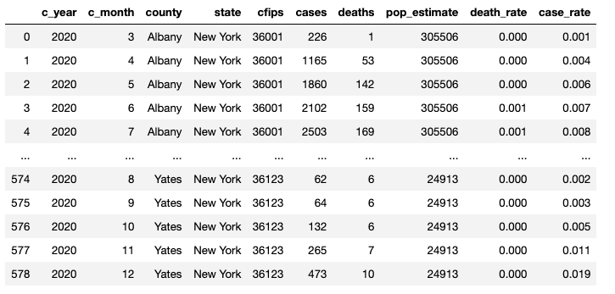
After a Bunch of Wizard Stuff ...
I finally got the data in a format that I can analyze and explore.
I am not ready to be a “data scientist.”

Slide 45
Why Did You Put Us Through That?
You got a sense of the essence of database and data.
Query languages.
Schema.
Operations on data.
Scale and performance.
And ...
Both programming and non-programming tracks will do work like what I just did.
The non-programming track does a lot more of it.
I know you are now afraid to ask, “But, what does the programming track have to do?”
What you learn in data science, machine learning, etc. courses.
What you learn in
this course.

Slide 46
IMDB
46 | COMS W4111_002_2021_1: Lecture 1: Introduction, Course Overview, Foundational Concepts © Donald F. Ferguson, 2021

Slide 47


Internet Movie Database (IMDB)

Slide 48
Web Application
IMDB Database
It would be “cool” if we
could look at the data directly!

Slide 49
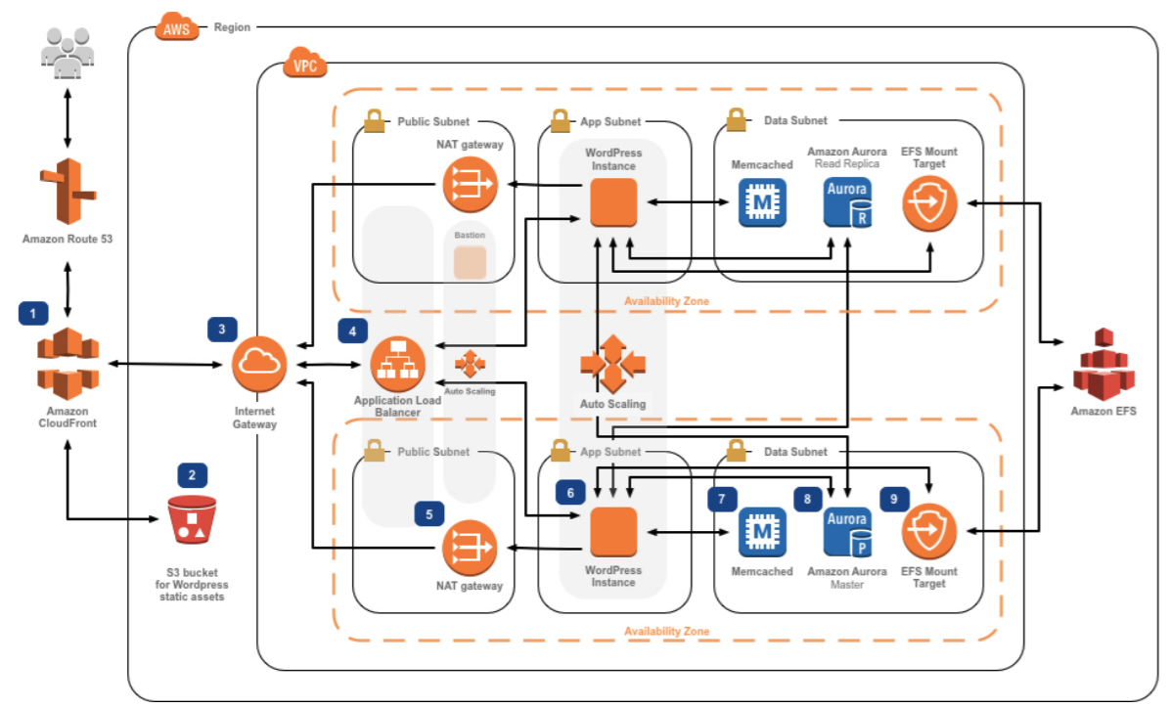
An Aside, Web Application are Complex
This is:
A trivial example.
From a tutorial.
Real solutions are staggering complex.

Slide 50
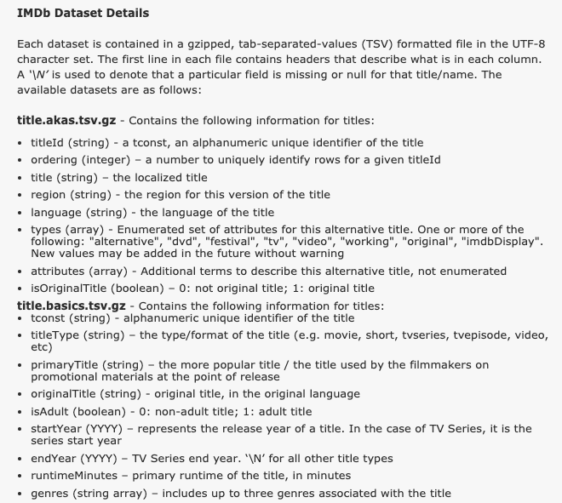
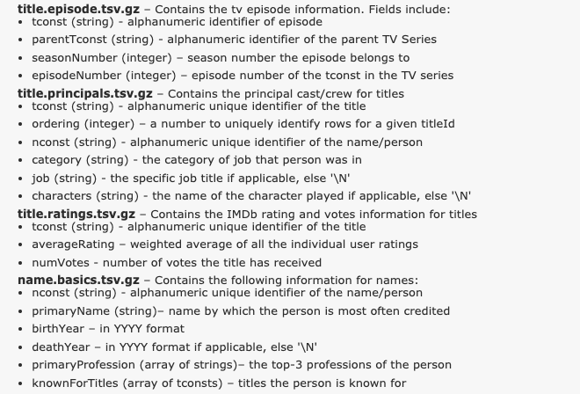
Well, we can download some of it!

Slide 51
But, ... The files are pretty big.
The uncompressed file size is about 5 GB.
Some of the files have a lot of rows:
name.basics approx. 10 million.
title.principals approx. 37 million.
There is no way I can
Open these in Excel
Let alone do my column-based joins.
And by “real world” DB standards, these files and tables are tiny.
DBs specialize in managing staggering large datasets and querying efficiently.
Applications enable users to interact with the data in meaningful ways.

Slide 52
How Does a Page Like this Work?
Well, overly simplistically ...
The web browser may a query https://www.imdb.com/find?q=%22tom+hanks
This produced the search results.
You clicked a link, and the browser made another query https://www.imdb.com/find?q=%22tom+hanks%22
The browser gets back to sets of “things.”
A page template with a bunch of slots.
Queries that determine what to put in the slots.
Based on
Context: previous queries, connections in data, ... ...
Policies: promotions, ad campaigns, ... ...
User info: prior queries, location, language, ... ...
... ...

Slide 53
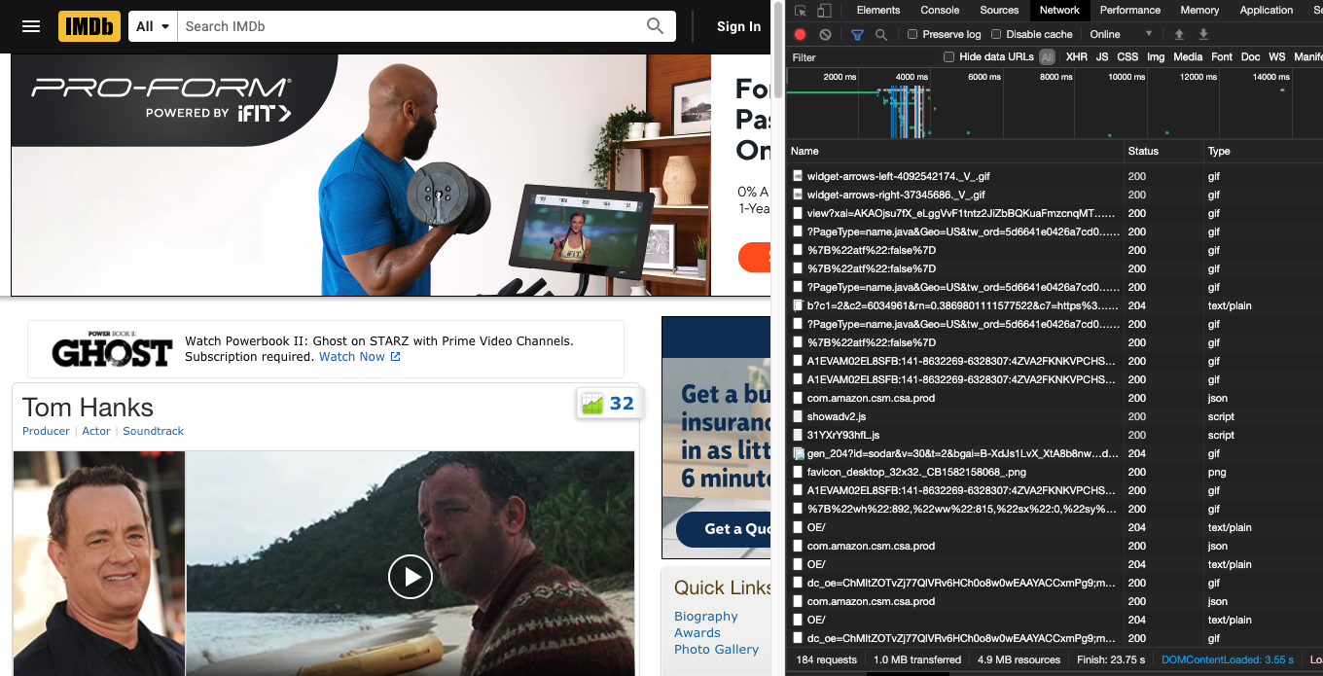
How Does a Page Like this Work?
One look up https://www.imdb.com/name/nm0000158 ==> 183 other look ups.

Slide 54
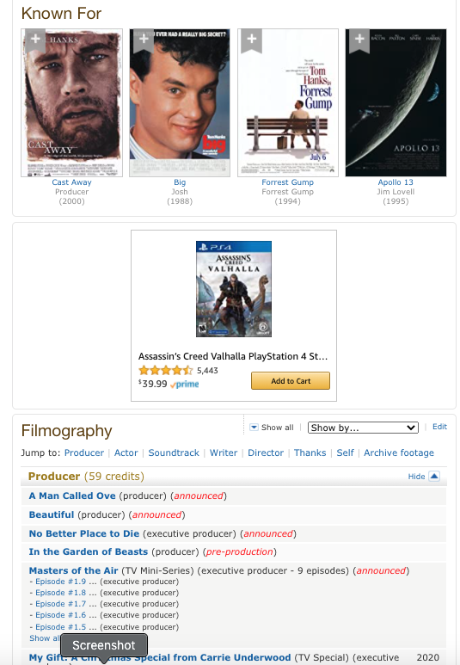
How did I Know this Information?
The core is answering 4 questions.
“Tom Hanks’” ID in my system is nm0000158
nm0000158 is known for:
tt0094737
tt0109830
tt0162222
nm0000158 had some kind of role in
tt0080202
tt0084314
tt0086927
tt0088161
tt0089543
tt0090274
tt0091019
tt0091541
tt0091653
... ...
The ability to turn ttxxxxxxx into useful information.

Slide 55
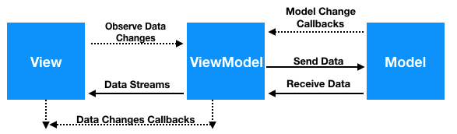
How this all Work?
There is a page
template with slots for “components”
W4170 teaches:
Page design
View
ViewModel
User experience
...
W4111 teaches
Model
Efficiency, design
... ...
HTML CSS
API Calls Data
JavaScript

Slide 56
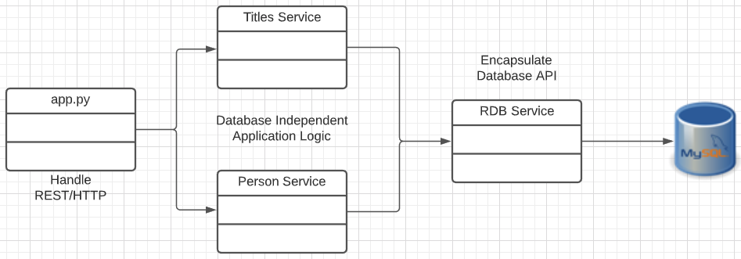
A Simple IMDB-Like Web Application
Downloaded Files
Browser
Display
Modified Angular Tour of Heroes Sample
https://angular.io/tutorial
Content/Code in browser
Load
Python Flask
HTTP/REST
Network
SQL Queries
Three components
Main application
People Dashboard
People Detail
One service: People
Very simple Python, Flask web application
https://flask.palletsprojects.com/en/1.1.x/

Slide 57
Let’s take a look ... ...
Walkthrough, ...
Browser.
Code walkthrough.
Some simple tests.
But, ...
I am going to use baseball data.
Because,
Over time we can do interesting numerical analysis and operations.
The database is a lot more complex.

Slide 58
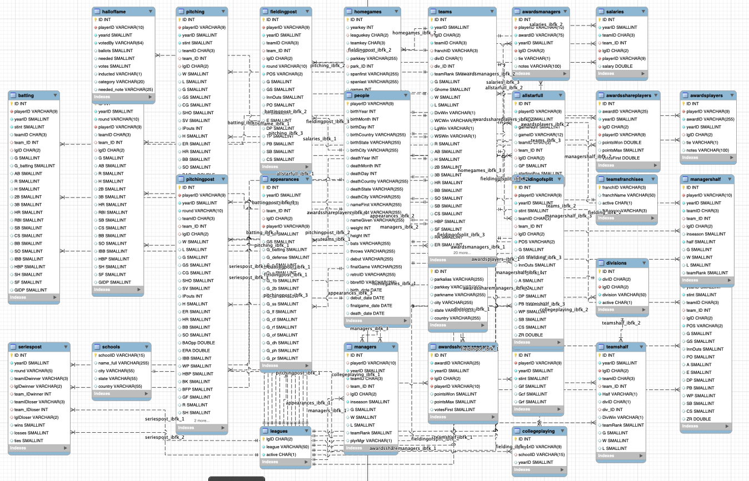
The Dreaded Lahman 2019 Baseball DB
This is:
An Entity-Relationship diagram.
In Crow’s Foot Notation.
The first few lectures will focus on:
Entity-Relationship Models
Notation and diagrams.
Realizations of the model:
Relational (Algebra) Model.
SQL
Understand how to use SQL to solve problems.
Incrementally make progress on a project in the space of web applications and/or data engineering.

Slide 59
Core Concepts:
Data
Databases
Database management systems.
Applications, application architectures.
Roles.
History of databases.
etc.
Covering these topics is not a good use of lecture time:
Read the slides for chapter 1 from the recommended textbook. (https://www.db-book.com/db7/slides-dir/PPTX-dir/ch1.pptx)
We will cover the material through questions on the reading, recitation, Piazza questions, ... ...
59 | COMS W4111_002_2021_1: Lecture 1: Introduction, Course Overview, Foundational Concepts © Donald F. Ferguson, 2021

Slide 60
Approach for First Few Lectures
60 | COMS W4111_002_2021_1: Lecture 1: Introduction, Course Overview, Foundational Concepts © Donald F. Ferguson, 2021

Slide 61
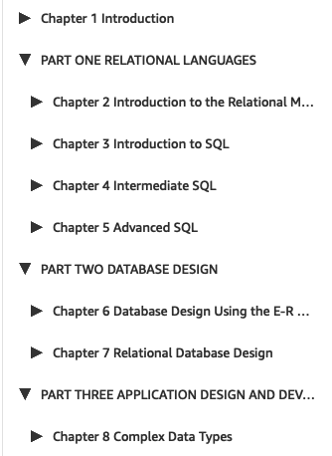
Lectures and Topics
Chapter 1:
Is interesting, but something easily learned from reading slides, docs, etc.
I can cover in OHs, recitation, Q&A, Piazza, ... ...
Books and standard syllabuses tend to be sequential. Cover and complete topics one at a time.
My view is that there is a core conceptual model with three realizations:
Entity, relationships, ... ...; the concepts.
ER design and modeling.
Implementation:
Relational model/algebra.
SQL.
Resource/REST oriented.
My approach is to incrementally and iteratively:
Introduce concepts.
Explain the realizations.
Because a implementing a real system requires the approach of concept, design, implement in several layers.

Slide 62
Database design, Entity-Relationship Model (Part 1)
Entity, relationship, attribute.
Database design process.
ER-Model and diagrams.
62 | COMS W4111_002_2021_1: Lecture 1: Introduction, Course Overview, Foundational Concepts © Donald F. Ferguson, 2021

Slide 63
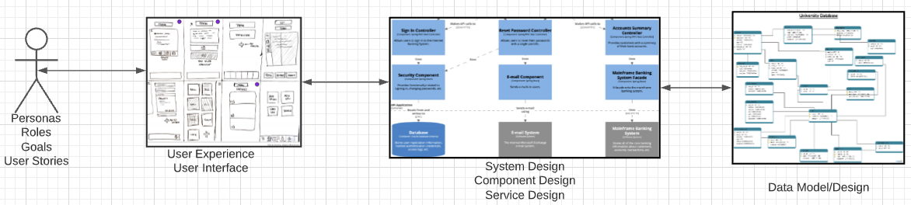
Problem Statement
We must build a system that supports academic operations in a university.
There are two major domains:
Interactive operations, e.g. register, choose class, assign grade, ... ...
Insight and reporting, e.g. enrollment trends, overloaded resources, ... ...
We will design, develop, test and deploy the system iteratively and continuously.
There are four core domains.
The processes are iterative, with continuous extension and details.
In this course,
We focus on the data dimension.
We will get some insight into the other dimensions.

Slide 64
Design Phases
Initial phase -- characterize fully the data needs of the prospective database users.
Second phase -- choosing a data model
Applying the concepts of the chosen data model
Translating these requirements into a conceptual schema of the database.
A fully developed conceptual schema indicates the functional requirements of the enterprise.
Describe the kinds of operations (or transactions) that will be performed on the data.
DFF Comments:
We you see slides with this formatting, the come directly from the presentations associated with the textbook. (https://www.db-book.com/db7/slides-dir/index.html)
The number at the bottom is of the form chapter.slide_no.
I try to put my comments, modifications and annotations in red text, or inside a red rectangle/callout.

Slide 65
Design Phases (Cont.)
Final Phase -- Moving from an abstract data model to the implementation of the database
Logical Design – Deciding on the database schema. Database design requires that we find a “good” collection of relation schemas.
Business decision – What attributes should we record in the database?
Computer Science decision – What relation schemas should we have and how should the attributes be distributed among the various relation schemas?
Physical Design – Deciding on the physical layout of the database
Notes:
65

Slide 66
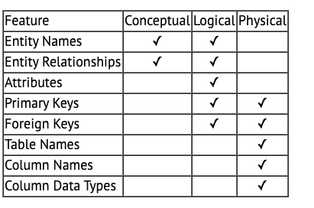
A Common and my Approach: Conceptual → Logical → Physical
https://ehikioya.com/conceptual-logical-physical-database-modeling/
https://www.1keydata.com/datawarehousing/data-modeling-levels.html
It is easy to get carried away with modeling. You can spend all your time modeling and not actually build the schema.
We will use the approaches in class.
Mostly to understand concepts and patterns.
https://www.1keydata.com/datawarehousing/data-modeling-levels.html

Slide 67
ER model -- Database Modeling
The ER data mode was developed to facilitate database design by allowing specification of an enterprise schema that represents the overall logical structure of a database.
The ER data model employs three basic concepts:
entity sets,
relationship sets,
attributes.
The ER model also has an associated diagrammatic representation, the ER diagram, which can express the overall logical structure of a database graphically.

Slide 68
Entity Sets
COMS W4111 002 01 2021
An entity is an object that exists and is distinguishable from other objects.
Example: specific person, company, event, plant
An entity set is a set of entities of the same type that share the same properties.
Example: set of all persons, companies, trees, holidays
An entity is represented by a set of attributes; i.e., descriptive properties possessed by all members of an entity set.
Example:
instructor = (ID, name, salary ) course= (course_id, title, credits)
A subset of the attributes form a primary key of the entity set; i.e., uniquely identifying each member of the set.
DFF Comments:
Some of these statements apply primarily to OO systems and the relational/SQL models.
A motivation for “No SQL” is to relax the constraints.

Slide 69
Entity Sets -- instructor and student

Slide 70
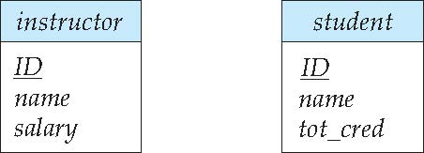
Representing Entity sets in ER Diagram
Entity sets can be represented graphically as follows:
Rectangles represent entity sets.
Attributes listed inside entity rectangle
Underline indicates primary key attributes

Slide 71
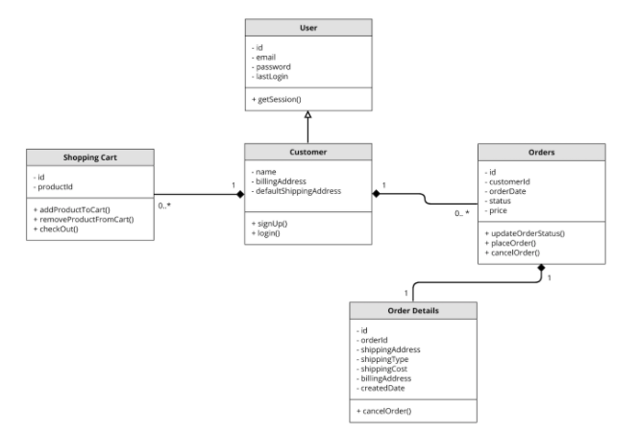
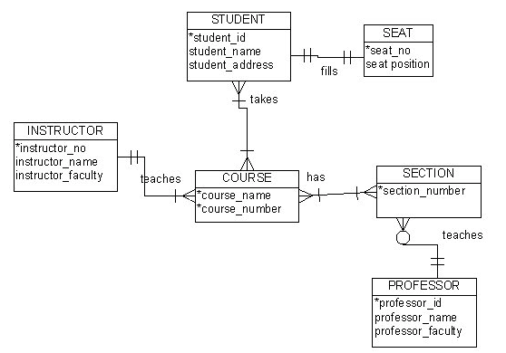
Visual Notation – Many Notations
ER Model
UML
“Other,” i.e. PowerPoint is the most common modeling notation.
It is easy to get “carried away.”
The trick is to do “just enough modeling.”
I mostly use Crow’s Foot
It is “just enough”
But lacks some capabilities.
The book uses ER notation.
Crow’s Foot

Slide 72
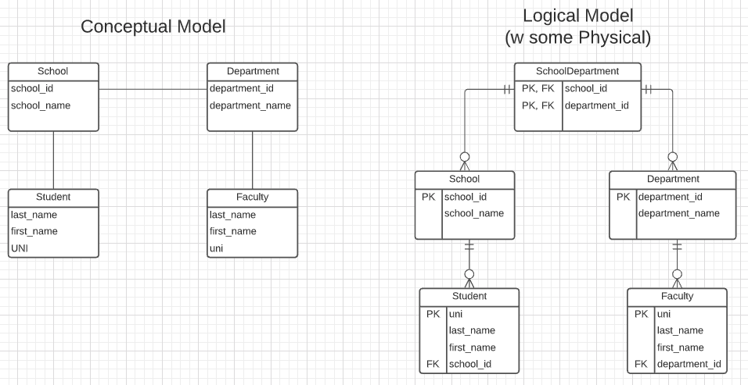
First Iteration/Step for University Data Model
This is the level of detail I want when I ask for:
Conceptual Model diagram.
Logical Model diagram.
Some online tools with “free,” constrained usage.
Lucidchart (https://www.lucidchart.com/)
Vertabelo (https://vertabelo.com/)
The model has:
Four entity sets: School, Department, Student, Faculty
Three relationship sets: Student-School, School-Department, Faculty-Department.

Slide 73
Entity Sets -- instructor and student
DFF Comments: Just a reminder of a previous slide.

Slide 74
Relationship Sets
A relationship is an association among several entities
Example: 44553 (Peltier) advisor 22222 (Einstein) student entity relationship set instructor entity
A relationship set is a mathematical relation among n ≥ 2 entities, each taken from entity sets
{(e₁, e₂, … e_{n}) | e₁ ∈ E₁, e₂ ∈ E₂, …, e_{n} ∈ E_{n}} where (e₁, e₂, …, e_{n}) is a relationship
Example:
(44553,22222) ∈ advisor
DFF Comments:
Nobody thinks about relationships this way.
There is no idea so simple that a DB professor cannot make it confusing, usually by using math.

Slide 75
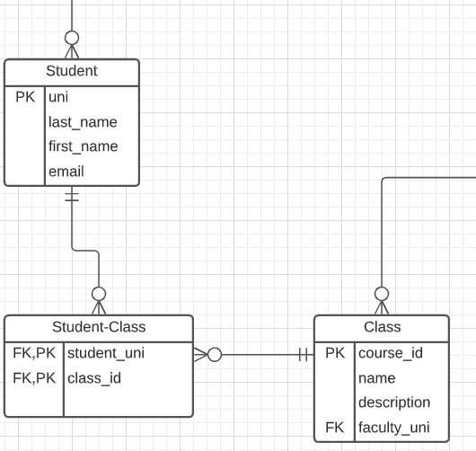
Relationship Sets (Cont.)
Example: we define the relationship set advisor to denote the associations between students and the instructors who act as their advisors.
Pictorially, we draw a line between related entities.
DFF Comments:
Nobody draws the diagrams this way, but ...
Sometimes thinking this way helps understand other ways to depict the concept.
(dff9, W4111)

Slide 76
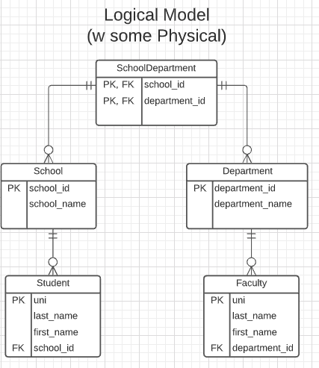
Notation has Precise Meaning
Attribute annotations:
PK = Primary Key
FK = Foreign Key
Line annotations:
We will learn over time and there are good tutorials (https://www.lucidchart.com/pages/er-diagrams) to help study and refresh.
We will spend a lot of time discussing keys.
We will start in a couple of slides.

Slide 77
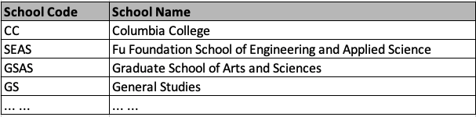
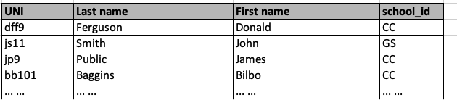
What Does this Mean? Let’s Get Started
Primary Key means that the value occurs at most once.
Foreign Key means that if a value occurs in school_id for any row, there must be a row in School with that key.
The line notations mean:
A student is related to EXACTLY ONE school.
A School may be related to 0, 1 or many students.

Slide 78
ER model -- Database Modeling
The ER data mode was developed to facilitate database design by allowing specification of an enterprise schema that represents the overall logical structure of a database.
The ER data model employs three basic concepts:
entity sets,
relationship sets,
attributes.
The ER model also has an associated diagrammatic representation, the ER diagram, which can express the overall logical structure of a database graphically.
DFF Comments:
The book and slides do not do a great job of motivating the ER model or ER diagrams.
Why do people and teams think about or use the ER model and modeling?

Slide 79

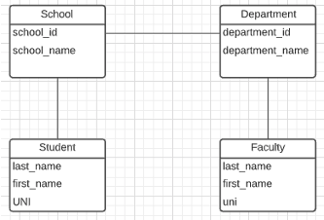
ER Model and ER Modeling
ER Model
Generalization
ER Model: Agility, Separation of Concerns
ER model is a generalization that most DB models implement in some form.
Using the ER model enables:
Thinking about and collaborating on design with getting bogged down in details.
Enable flexible choices about how to realize/Implement data.
ER Diagrams: Communication, Quality, Precision
With a little experience, everyone can understand and ER diagram.
Easier to discuss and collaborate on application’s data than showing SQL table definitions, JSON, ... ...
People think visually. That is why we have whiteboards. ER diagrams are precise and unambiguous.
Guides you to think about relationships, keys, ... And prevents “re-dos” later in the process. It is easier to fix a diagram than a database schema.
Specialization
Relational
Doc Model
Graph Model
... ...
UI UX
Business Professional
Business Service Developer
DB Pros

Slide 80
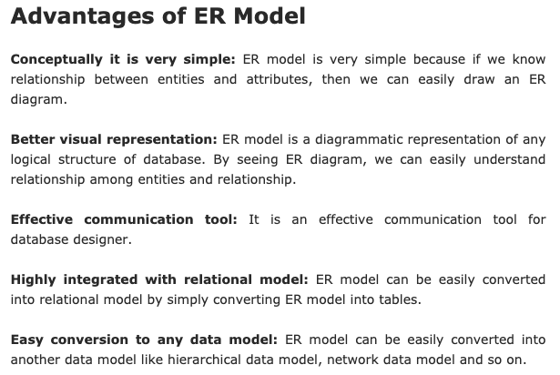
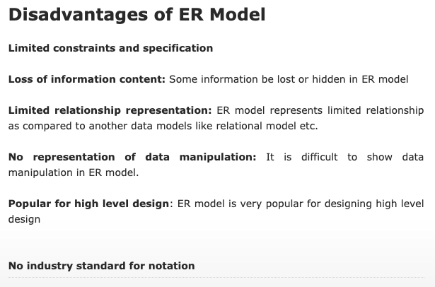
ER Modeling – Reasonably Good Summary
https://pctechnicalpro.blogspot.com/2017/04/advantages-disadvantages-er-model-dbms.html
Note:
If you get to use Google to help with take home exams, HW, etc.
I get to use Google to help with slides.

Slide 81
The Relational Model
81 | COMS W4111_002_2021_1: Lecture 1: Introduction, Course Overview, Foundational Concepts © Donald F. Ferguson, 2021

Slide 82

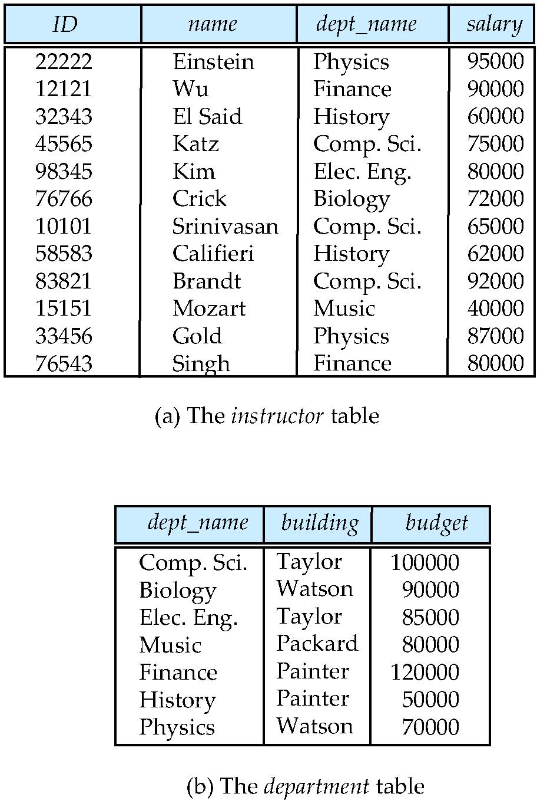
Relational Model
All the data is stored in various tables.
Example of tabular data in the relational model
Columns
Ted Codd Turing Award 1981
The “relation” is the “table.”
In my big space of pieces of data. ID, name, dept_name, salary are somehow related.
This causes confusion, because the ER and other models use “relation” to mean something else.
Core concepts:
Relation
Tuple (Row)
Column (Attribute)
Rows
Notes:
82

Slide 83
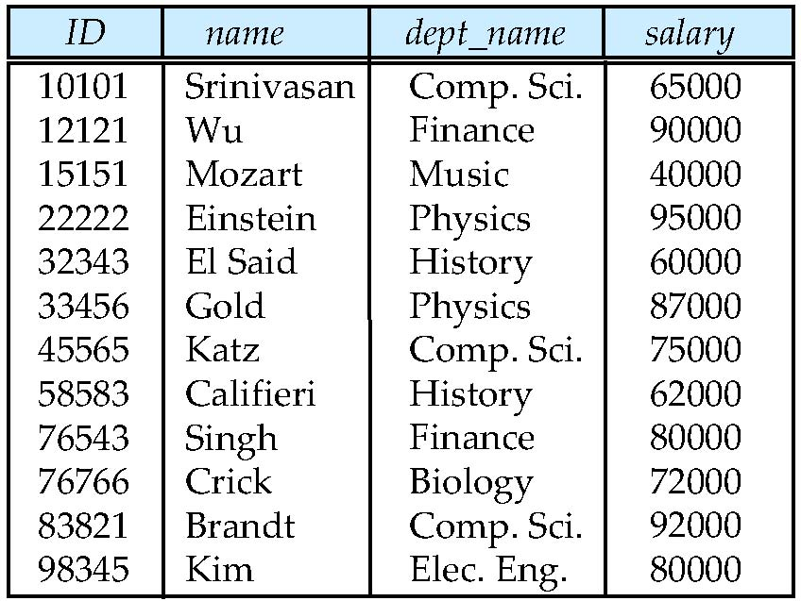
Example of a Instructor Relation
attributes
(or columns)
tuples
(or rows)

Slide 84
Attribute
The set of allowed values for each attribute is called the domain of the attribute
Attribute values are (normally) required to be atomic; that is, indivisible
The special value null is a member of every domain. Indicated that the value is “unknown”
The null value causes complications in the definition of many operations
DFF Comments:
I will explain the importance of atomic attributes and null in examples.
Atomic and use of Null is important?

Slide 85
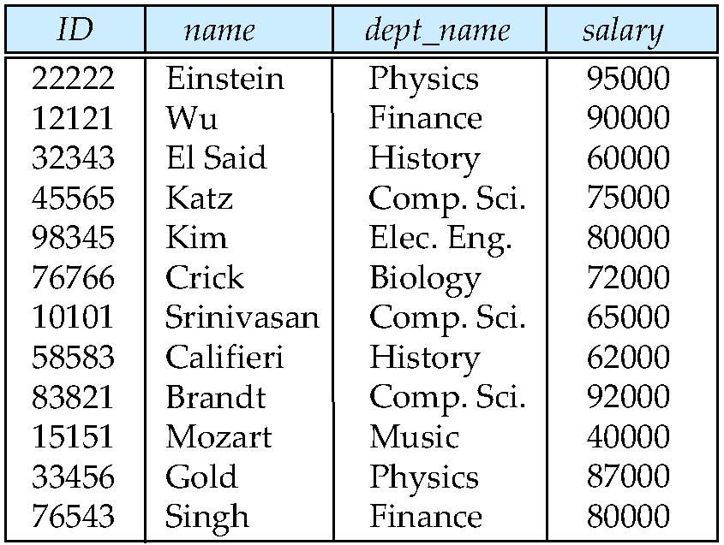
Relations are Unordered
Order of tuples is irrelevant (tuples may be stored in an arbitrary order)
Example: instructor relation with unordered tuples

Slide 86
Database Schema
Database schema -- is the logical structure of the database.
Database instance -- is a snapshot of the data in the database at a given instant in time.
Example:
schema: instructor (ID, name, dept_name, salary)
Instance:

Slide 87
Keys
Let K ⊆ R
K is a superkey of R if values for K are sufficient to identify a unique tuple of each possible relation r(R)
Example: {ID} and {ID,name} are both superkeys of instructor.
Superkey K is a candidate key if K is minimal Example: {ID} is a candidate key for Instructor
One of the candidate keys is selected to be the primary key.
which one?
Foreign key constraint: Value in one relation must appear in another
Referencing relation
Referenced relation
Example: dept_name in instructor is a foreign key from instructor referencing department

Slide 88
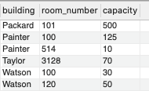
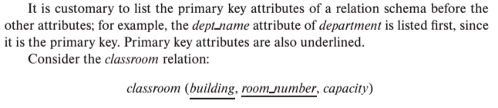
Notation
Classroom relation
classroom schema
Columns (Attributes)
Relation Name
Primary Key Columns
The primary key is a composite key. Neither column is a key (unique) by itself.
Keys are statements about all possible, valid tuples and not just the ones in the relation.
Capacity is unique in this specific data, but clearly not unique for all possible data.
In this domain, there cannot be two classrooms with the same building and room number.
Relation schema:
Underline indicates a primary key column. There is no standard way to indicate other types of key.
We will use bold to indicate foreign keys.
You will sometimes see things like classroom(building:string, room_number:number, capacity:number)

Slide 89
Observations
Keys:
Will be baffling. It takes time and experience to understand/appreciate.
There are many, many types of keys with formal definitions.
I explain the formality but focus on the concepts and applications.
No one uses the formal, relational model. So, why do we study it?
Is very helpful when understanding concepts that we cover later in the course, especially query optimization and processing.
There are many realizations of the model and algebra, and understanding the foundation helps with understanding language/engine capabilities.
The model has helped with innovating new approaches, and you may innovate in data and query models in your future.

Slide 90
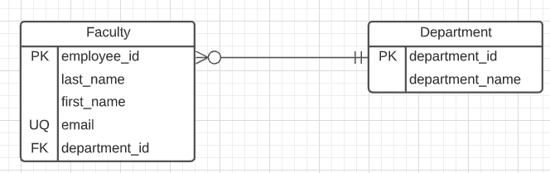
Start Building our Datamodel
First two relations:
Departments(title, id)
Faculty(employee_id, first_name, last_name, email, department_id)
Note:
email is almost certainly a candidate key.
A primary key is chosen arbitrarily. Why did I use employee_id?
Heuristic: People may change emails. I may lose “identity” in the data over time. Same person but two different emails.
employee_id is immutable. I cannot change.
ER Diagram:
Note: “UQ” is my non-standard convention.
Relationship:
A faculty “has” exactly one department.
A department as 0, 1 or many faculty.

Slide 91
Start Building our Datamodel
First two relations:
Departments(title, id)
Faculty(employee_id, first_name, last_name, email, department_id)
Note:
email is almost certainly a candidate key.
A primary key is chosen arbitrarily. Why did I use employee_id?
Heuristic: People may change emails. I may lose “identity” in the data over time. Same person but two different emails.
employee_id is immutable. I cannot change.
ER Diagram:
Note: “UQ” is my non-standard convention.
Relationship:
A faculty “has” exactly one department.
A department as 0, 1 or many faculty.
OK, that is interesting, but ... ...
Where does the data come from?
Users enter and update data through an application.
You can import pre-existing data.
You can generate test data.
How do you “manipulate” the data (CRUD)
Create.
Retrieve.
Update.
Delete.

Slide 92
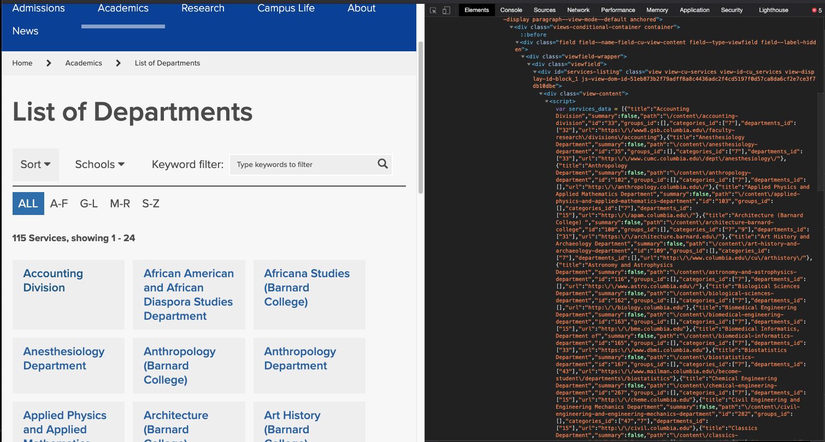
Import the Data – I screen-scraped the Website

Slide 93
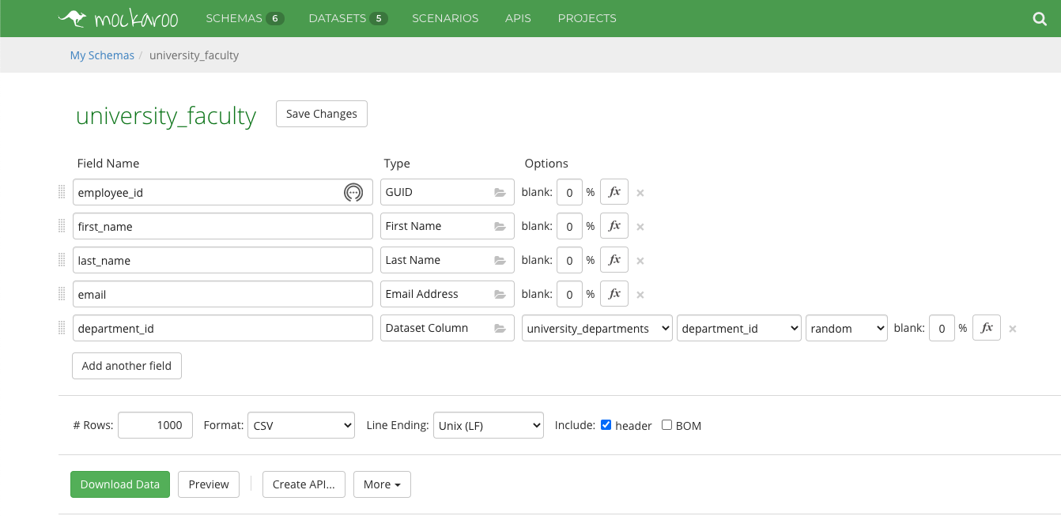
Generate Test Data – I Used to Tool

Slide 94
Relational Query Languages
Procedural versus non-procedural, or declarative
“Pure” languages:
Relational algebra
Tuple relational calculus
Domain relational calculus
The above 3 pure languages are equivalent in computing power
We will concentrate in this chapter on relational algebra
Not turning-machine equivalent
Consists of 6 basic operations
DFF Comments:
You will sometimes see other operator, e.g. ← Assignment.
Relational algebra focuses on retrieve. You can sort of do Create, Update, Delete.
The SQL Language, which we will see, extends relational algebra.

Slide 95
Relational Algebra
A procedural language consisting of a set of operations that take one or two relations as input and produce a new relation as their result.
Six basic operators
select: σ
project: ∏
union: ∪
set difference: –
Cartesian product: x
rename: ρ

Slide 96
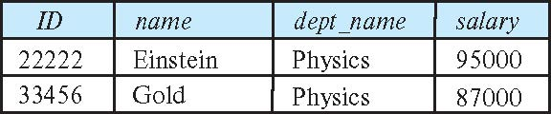
Select Operation
The select operation selects tuples that satisfy a given predicate.
Notation: σ _{p} (r)
p is called the selection predicate
Example: select those tuples of the instructor relation where the instructor is in the “Physics” department.
Query
σ _{dept_name=“Physics”} (instructor)
Result

Slide 97
Select Operation (Cont.)
We allow comparisons using
=, ≠, >, ≥. <. ≤
in the selection predicate.
We can combine several predicates into a larger predicate by using the connectives:
∧ (and), ∨ (or), ¬ (not)
Example: Find the instructors in Physics with a salary greater $90,000, we write:
σ _{dept_name=“Physics”} ∧ _{salary} > 90,000 (instructor)
Then select predicate may include comparisons between two attributes.
Example, find all departments whose name is the same as their building name:
σ _{dept_name=building} (department)

Slide 98
Project Operation
A unary operation that returns its argument relation, with certain attributes left out.
Notation:
∏ _{A1,A2,A3 ….Ak} (r)
where A₁, A₂ are attribute names and r is a relation name.
The result is defined as the relation of k columns obtained by erasing the columns that are not listed
Duplicate rows removed from result, since relations are sets

Slide 99
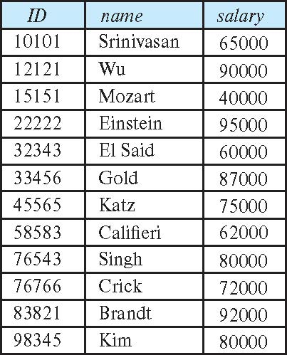
Project Operation (Cont.)
Example: eliminate the dept_name attribute of instructor
Query: ∏_{ID, name, salary} (instructor)
Result:

Slide 100
Composition of Relational Operations
The result of a relational-algebra operation is relation and therefore of relational-algebra operations can be composed together into a relational-algebra expression.
Consider the query -- Find the names of all instructors in the Physics department.
∏_{name}(σ _{dept_name} _{=“Physics”} (instructor))
Instead of giving the name of a relation as the argument of the projection operation, we give an expression that evaluates to a relation.

Slide 101
Relax Calculator
Let’s look at an online tool that you will use.
RelaX (https://dbis-uibk.github.io/relax/calc/local/uibk/local/0)
The calculator:
Does have the sample data from the textbook.
You can also upload new data. (Show how and example)
Some queries:
σ title='Computer Science Department' ∨ title='Accounting Division' (departments)
π last_name, email (faculty)
π last_name, email ( σ department_id=165 ∨ department_id=1010 (faculty) )

Slide 102
SQL
102 | COMS W4111_002_2021_1: Lecture 1: Introduction, Course Overview, Foundational Concepts © Donald F. Ferguson, 2021

Slide 103
History
IBM Sequel language developed as part of System R project at the IBM San Jose Research Laboratory
Renamed Structured Query Language (SQL)
ANSI and ISO standard SQL:
SQL-86
SQL-89
SQL-92
SQL:1999 (language name became Y2K compliant!)
SQL:2003
Commercial systems offer most, if not all, SQL-92 features, plus varying feature sets from later standards and special proprietary features.
Not all examples here may work on your particular system.

Slide 104
SQL Parts
DML -- provides the ability to query information from the database and to insert tuples into, delete tuples from, and modify tuples in the database.
integrity – the DDL includes commands for specifying integrity constraints.
View definition -- The DDL includes commands for defining views.
Transaction control –includes commands for specifying the beginning and ending of transactions.
Embedded SQL and dynamic SQL -- define how SQL statements can be embedded within general-purpose programming languages.
Authorization – includes commands for specifying access rights to relations and views.

Slide 105
SQL Language Statements
The core SQL language statements are:
SELECT: Implements both σ, π
INSERT
UPDATE
DELETE
CREATE TABLE
ALTER TABLE
JOIN, which is an operator within SELECT.
Many, if not most, SQL statements:
Require multiple relational algebra expressions.
Cannot easily (or at all) be represented in relational algebra.
π last_name, email (
σ department_id=165 ∨ department_id=1010 (faculty)
)
=
SELECT last_name, email FROM faculty WHERE department_id=165 or
department_id=1019

Slide 106
Data Definition Language
The SQL data-definition language (DDL) allows the specification of information about relations, including:
The schema for each relation.
The type of values associated with each attribute.
The Integrity constraints
The set of indices to be maintained for each relation.
Security and authorization information for each relation.
The physical storage structure of each relation on disk.

Slide 107
Create Table Construct
An SQL relation is defined using the create table command:
create table r
(A₁ D₁, A₂ D₂, ..., A_{n} D_{n}, (integrity-constraint₁), ..., (integrity-constraint_{k}))
r is the name of the relation
each A_{i} is an attribute name in the schema of relation r
D_{i} is the data type of values in the domain of attribute A_{i}
Example:
create table instructor ( ID char(5), name varchar(20), dept_name varchar(20), salary numeric(8,2))

Slide 108
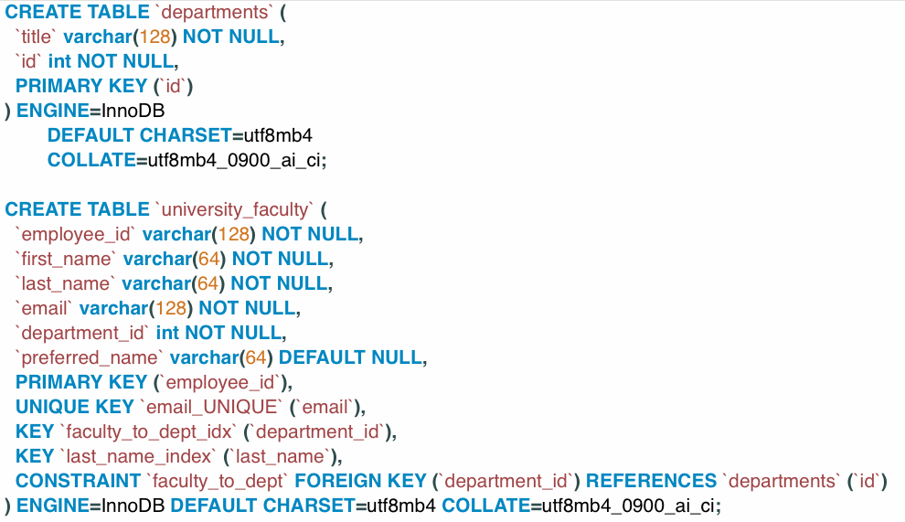
SQL Create Table for our Datamodel
The ` (back tick) is optional in most cases.
You can look up the various column types.
INT is an integer.
VARCHAR(N) is a variable length string with maximum length 128.
DEFAULT CHARSET, ENGINE, COLLATE are MySQL specific and you can usually ignore.
NOT NULL is a Constraint. Constraints are core parts of SQL and we will cover in detail.
Keys/Constraints/Index
You can see PRIMARY KEY definition.
UNIQUE KEY is similar to Candidate Key. UNIQUE KEY and the columns NOT NULL is a Candidate Key.
Foreign key defines source columns and reference columns.
“Key” sometimes means “Index” and is just used for performance.
Some databases conflate the concepts of Key and Index. We will cover both keys and indexes in detail.

Slide 109

Crow’s Foot Like Physical Diagram
It is possible to draw a physical model in an ER Diagram tool and generate the CREATE TABLE statements.
I never to do.
I find it more trouble than it is worth.
I will reverse engineer an existing database to understand its schema.

Slide 110
Switch to Jupyter Notebook and DataGrip
Show some queries.

